Slide 1
Volunteer Orientation
Cornell Cooperative Extension is an employer and educator recognized for valuing AA/EEO, Protected Veterans, and Individuals with Disabilities and provides equal program and employment opportunities.
Notes:
Thank you for joining us at Cornell Cooperative Extension of Jefferson County. Your volunteer service to our organization will provide lasting benefits to our community and its residents. Welcome!

Slide 2
What is Cornell Cooperative Extension?
It all started with President Abraham Lincoln.
Notes:
President Abraham Lincoln provided the groundwork necessary for the creation of today’s nationwide Extension system.

Slide 3
Land Grant History
Three acts signed by President Lincoln in 1862 shaped the US Agricultural history:
Act authorizing a US Department of Agriculture;
AKA: NIFA (National Institute of Food and Agriculture) formerly USDA
The Homestead Act, encouraging settlement of public domain lands;
The Morrill Act establishing land grant colleges in every state and placing instruction in agriculture and home economics in higher education.
How can we educate all the new landowners, many of which are poor, about farming?
Notes:
In 1862, President Lincoln signed three acts:
The first act created the US Department of Agriculture (USDA), today known as the National Institute of Food and Agriculture (NIFA).
The Homestead Act encouraged the settlement of public domain lands, which were practically free.
Justin Smith Morrill, a Representative and later a Senator from Vermont, sponsored the land-grant legislation that bears his name. Every state in the nation created a land grant college to provide instruction in agriculture and economics. But what about the poor who could not afford to attend college? This was the basis for the creation of our nationwide Cooperative Extension system.

Slide 4
Here is how…
Let’s be friends: The history and formation of the Cooperative Extension dates back to The Hatch Act of 1887 which established a cooperative bond between the USDA and the nation's land grant colleges allocating annual federal funding for research.
Bringing it all together: The Smith-Lever Act in 1914 provided funds for cooperative administration of agricultural extension education by USDA (NIFA) and the state land grant colleges.
Notes:
The Hatch Act, which provided federal funding for agricultural research, established a bond between the USDA and our land grant colleges. The Smith Lever Act provided the funding for extension of this research-based knowledge to local farmers, thus improving the productivity of farms and building up the economy and communities.

Slide 5
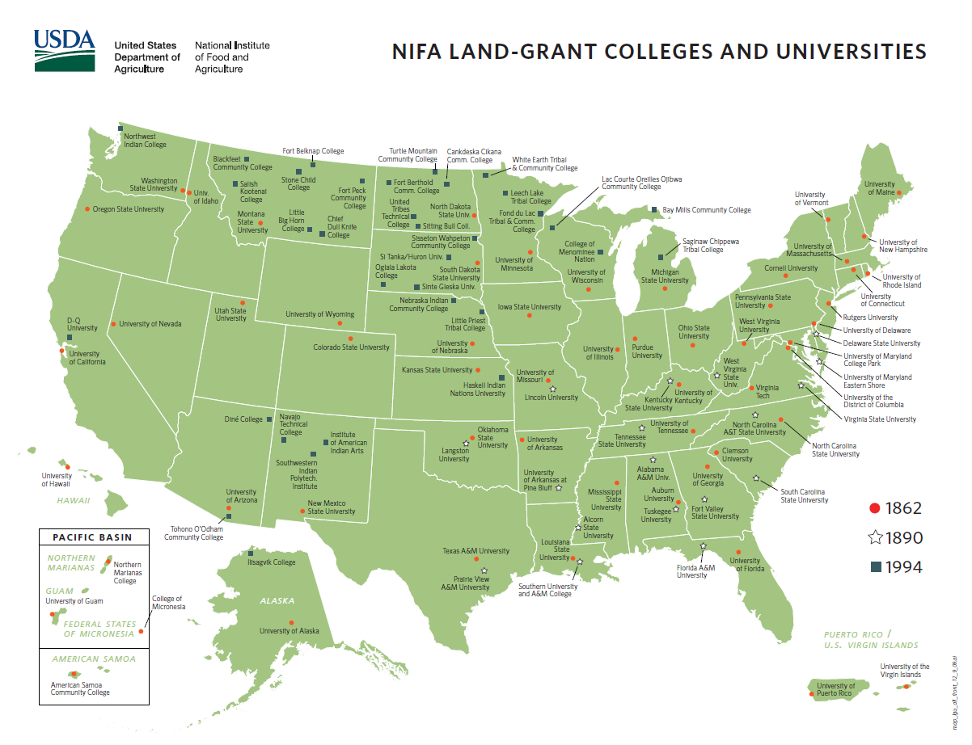
Land Grant College map
Notes:
As shown in this map, there is now at least one land-grant institution in every state and territory of the United States, as well as the District of Columbia. Certain Southern states have two land-grant institutions as a result of the Second Morrill Act passed in 1890, and some western and plains states have several of the 1994 land-grant tribal colleges. Let’s learn more about the land grant college in New York State.

Slide 6
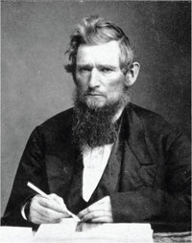
Our Connection:
Cornell University:
Ezra Cornell founded the Land Grant University for New York in 1865!
CCE has been operating for over 100 years…
Date of Birth: January 11, 1807 Date of Death: December 9, 1874
Notes:
State Senator Ezra Cornell donated land to be used for New York State’s land grant college. The result is Cornell University. Cornell Cooperative Extension began operation in 1911 in Broome County and brought the research knowledge gained by the University to the local residents. Jefferson County was the second county Extension office in New York State, founded in 1912. There is now an extension office in almost every county in New York State. It is important to note that, while Extension staff throughout New York State are often working on collaborative projects, each county extension association operates as a separate entity. They each have their own budget and each determine which programs will best assist the residents in their county.

Slide 7
Relationship with Cornell University
We take the research-based information generated at the University and bring it to county residents, educating them in the following program areas:
Agriculture and Natural Resources
Community Development
Fort Drum/Military Support
Nutrition and Health
Parenting
4-H Youth Development
Notes:
The main program areas at Cornell Cooperative Extension of Jefferson County are agriculture, community development, nutrition, and youth and family development. Education is delivered through hands-on workshops, one-on-one contacts, print, social media, television, radio, public presentations, and more! Please be sure to visit the rest of our website to see everything that we offer to the residents of Jefferson County – most free of charge!

Slide 8
Cornell Cooperative Extension of St. Lawrence County
Mission Statement Cornell Cooperative Extension Association of St. Lawrence County educates youth, families, farmers, and communities using research-based knowledge for practical application and lifelong learning.
Vision Statement
Our vision is to be recognized as a leading community organization delivering dynamic and empowering educational opportunities that address the evolving needs of all individuals in our region.
Notes:
Please take a moment to read our mission and vision statements.

Slide 9
Contact Information
Address: 2043B SH 68
Canton, NY 13617
Hours: Monday-Friday, 8:00 AM - 4:30 PM
Phone: 315-379-9192
Email: tlh233@cornell.edu
Website: https://stlawrence.cce.cornell.edu
Facebook: https://www.facebook.com/CCEofSLC
4-H Volunteer Coordinator: Tamara Hill
Notes:
Should we be able to assist you in any way or if you have questions, please do not hesitate to contact us. A list of senior management can be found on the following slide.

Slide 10
Why are volunteers so important to Cooperative Extension?
The combined efforts of thousands of dedicated Cornell Cooperative Extension volunteers are worth millions of dollars in New York State.
Volunteers bring a diversity of experiences, knowledge, and skills to the programs we offer and the county residents we serve.
Volunteer skills and time allow us to provide important programs to county residents that we otherwise would be unable to support.
Notes:
Cornell Cooperative Extension of Jefferson County would not be able to deliver many of our programs without the assistance of engaged and talented volunteers. The expertise of our volunteer board and committee members drives our programs to make sure the education we provide is relevant to the needs of our county residents. 4-H Leaders, Master Gardeners and other volunteers regularly work directly with the youth and adults of our county to deliver hands-on, engaging knowledge for the betterment of our community. We would not be able to deliver specific programs without volunteer program assistants and overnight chaperones.

Slide 11
Types of Volunteers
Casual Volunteers: (supervised)
Minimal Training/Screening
Advisory Committee members/program assistants
Enrolled Volunteers: (unsupervised)
Required Training/Screening
4-H Leaders, Master Gardeners, overnight chaperones
Elected Volunteers:
Board Members
Notes:
The type of position you are volunteering for on behalf of our Association determines the depth of background screening required. Every volunteer must complete an application and be approved before beginning their service. A criminal background screening, repeated every three years, is required for all volunteers unless you are only volunteering for only one day a year and not be in a supervisory position. If you will be driving on our behalf, a DMV check is required. All volunteers must agree to a specific code of conduct and enrolled volunteers must sign a volunteer agreement. In addition, enrolled volunteers must also be interviewed, with two reference checks performed. All our volunteer screening requirements are based on events at other organizations, and are in compliance with our insurance underwriter.

Slide 12
Volunteers Represent Extension and as such,
Act on behalf of an educational organization with a long-standing reputation
Set an example in the community for youth and others to follow
Demonstrate sound, quality, research-based information
Respect the diversity of our county residents, providing equal program opportunities to everyone.
Notes:
Why must volunteers sign an established code of conduct? Our excellent reputation is based on providing high quality, research-based programs that are relevant to the needs of all our county residents. These programs are delivered by well-trained, respected educators who put the needs of our clients first. Our volunteers must be equal to the task.

Slide 13
Responsibilities of Volunteers
Volunteers represent Cornell Cooperative Extension and have the responsibility to:
abide by Extension policies and external regulations that govern your actions;
execute Extension business in an ethical manner and uphold the established Code of Conduct;
preserve confidentially regarding clients as well as internal Extension affairs;
accept assignments suitable to your skills and time availability, and complete those assignments; and
work as a team member with staff and volunteers.
Notes:
Please take a moment to review your responsibilities as a volunteer. Should you have any questions, please do not hesitate to contact your volunteer coordinator.

Slide 14
Responsibilities of Extension
What do you receive as an Extension volunteer?
Orientation, training, and supervision to enhance effective use of your interests, skills, and time
Pertinent information and communications appropriate to your status
Respect, recognition, and trust earned through your performance
A safe environment and protection from liability claims arising from volunteer assignments
A process for addressing concerns and conflicts
Notes:
In addition to the items listed here, keep in mind that you will have access to educational resources and programs that may help you discover new interests and develop new skills. Most of all, you will be assisting in the development or delivery of community programs to our residents, helping to shape our community’s future.

Slide 15
Speaking of liability…
All volunteers are covered under general liability insurance, only when they are acting within the scope of their assigned volunteer responsibilities.
If you are driving your own vehicle as part of your volunteer responsibilities, you must be insured according to NYS Motor Vehicle Law as Extension does not provide coverage.
Notes:
Volunteers are covered under a general liability policy through Extension. A more detailed account of this and other insurance coverages is located on our website. Should you have any questions, please contact your volunteer coordinator.

Slide 16
In case of an emergency…
Be sure to follow all safety precautions for any equipment you are using.
Know the location of the first aid kit and emergency phone numbers at all times.
Should a major incident arise, put a responsible person in charge and take care of the emergency.
Do not make any statement to the media or anyone else other than Extension staff.
Call 315-379-9192 to report the incident.
Notes:
Before beginning any program, make sure you know the location of the first aid kit and have emergency phone numbers with you at all times. A form for reporting injuries that occur during one of our programs can be found on our website. Contact the volunteer coordinator or executive director as soon as possible in case of an emergency.

Slide 17
Communicating with Staff
All printed materials must be approved by the organization (speak with the Volunteer Coordinator or your program leader)
All programs and events we commit to must be approved by the appropriate staff person.
Additional trainings or regular meetings may be a part of your program’s requirements.
Association fundraising policies must be followed. See the guidelines on our website.
Notes:
It is important to remember that no materials may be distributed that have not been approved by our office. Your volunteer coordinator or program contact can assist you with what is required. At Cornell Cooperative Extension, we work from pre-existing, pre-approved, research-based information. Any other materials have to undergo review and approval before their use. Sometimes events or programs require special agreements and planning, so always speak with your volunteer coordinator or program contact before committing to a particular program.

Slide 18
Additional Resources
Program-specific Orientations
List of Acceptable and Prohibited Program Activities
Guidelines, Policies, and Procedures
Position Descriptions
4-H Volunteer Coordinator, Tamara Hill
315-379-9192 or tlh233@cornell.edu
Notes:
Additional information regarding your role as an Extension volunteer can be found on our website or by contacting your program supervisor. Please take time to review these resources before you begin your volunteer service. As always, simply contact the volunteer coordinator if you have any questions.

Slide 19
Welcome to Cornell Cooperative Extension of St. Lawrence County!
Notes:
Thank you for choosing to support Cornell Cooperative Extension of Jefferson County with your volunteer service. Without your assistance, we would not be able to provide all our current programs to the residents of Jefferson County. Together we will work for the betterment of our community and its residents. WELCOME!

